Slide 1

AKS Office Hours
Kendall Roden
Cloud Native Technical Specialist
Kendal Roden
Cloud Native Technical Specialist
Dave Strebel
Cloud Native Technical Specialist

Slide 2
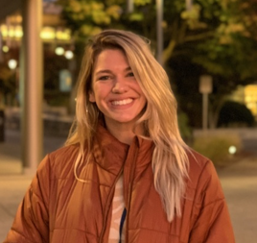
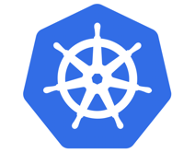


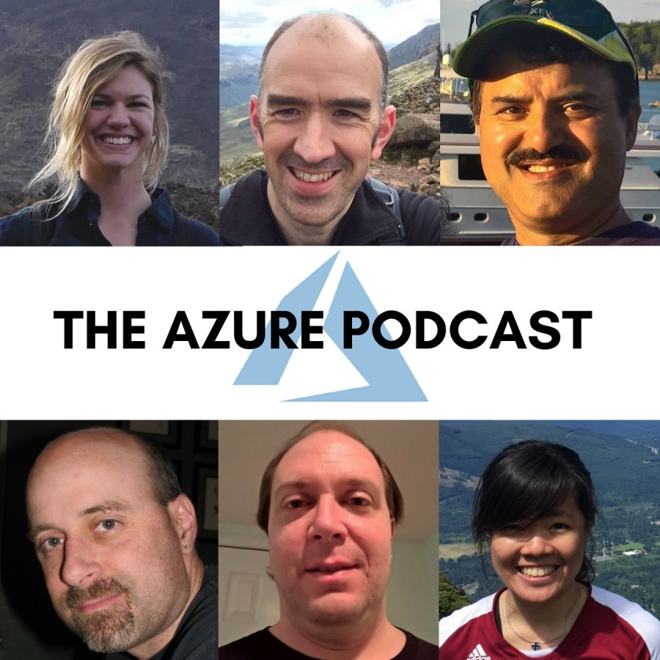

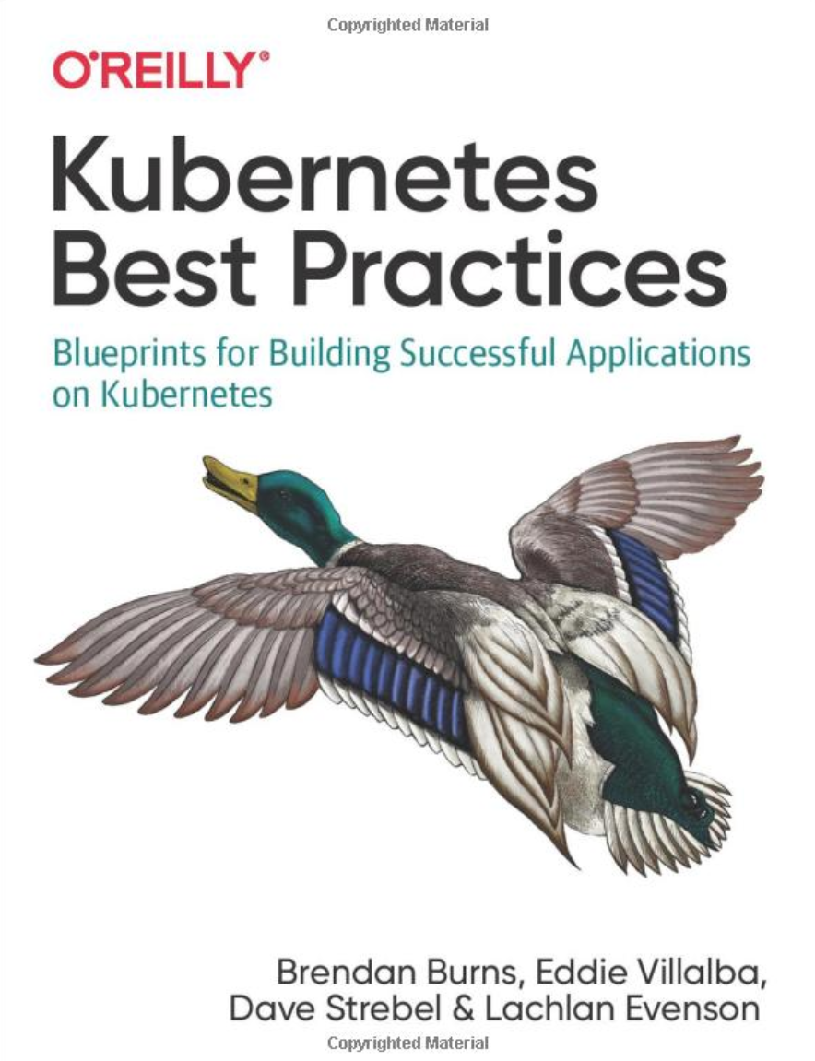
Who are we?
@kendallroden​
@dave_strebel​

Slide 3
Why AKS Office Hours?
Provide AKS customers with updates pertaining to AKS and the Cloud Native Ecosystem
Host a short talk and/or demo on Cloud Native technologies related to Kubernetes and AKS
Collect feedback from customers on issues, blockers, use cases, and questions related to AKS

Slide 4
What to expect
Call agenda
5-10 minutes: Welcome, followed by AKS and ecosystem updates
20-30 minutes: AKS Private Clusters with Ray Kao – Cloud Native Technical Specialist
20-30 minutes: “Ask us anything” and customer feedback discussion
Keep in mind
We want two-way interaction, but please stay on mute when you are not speaking
This call and how it is conducted will evolve based on feedback and growth
Office hours are hosted primarily by the GBB team, with the support of the PG
Recordings and content will be available post-call, barring any technical difficulties
Contact us with thoughts, ideas or questions (aksofficehours@microsoft.com)

Slide 5

AKS Updates

Slide 6
AKS Updates
GA
AKS Managed Azure AD Integration
Integration with Azure Advisor
Optional Uptime SLA
0 Node Nodepools
Preview
Azure Spot Instances
Azure Policy v3 (Gatekeeper) and Azure Policy for Pod Security Policy
Node Image Upgrade
Application Gateway Ingress Controller Managed Addon
Integration with Azure Resource Health
Ephermal OS disk support
Support for Ubuntu 18.04 and ContainerD

Slide 7
Ecosystem Updates

Slide 8
Ecosystem Updates
Certified Kubernetes Administration Exam Updated
New Docker Hub limitations – 100 pulls per 6 hours
Thanos and K3s added as sandbox projects to CNCF
Kubecon EU sessions now on Youtube

Slide 9

Azure Kubernetes Service Private Clusters
Ray Kao
OSS/Cloud Native Architect
Azure Global Black Belt Team

Slide 10
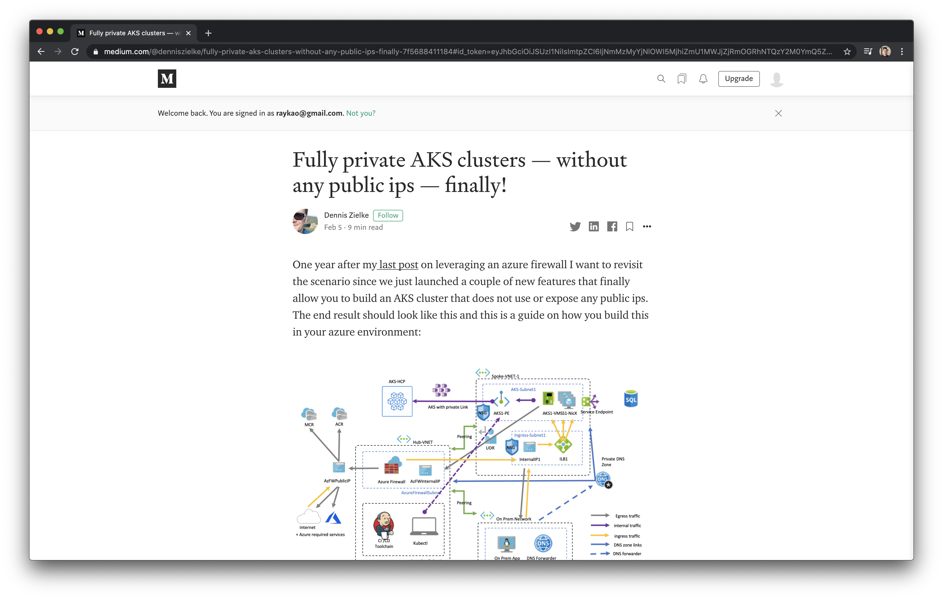
Fully Private AKS Clusters
https://medium.com/@denniszielke/fully-private-aks-clusters-without-any-public-ips-finally-7f5688411184

Slide 11
Private Clusters
AKS Private Clusters
AKS/K8s control plane is only addressable over private networking (Azure VNET/Backbone)
No Publicly (Internet Addressable
https://docs.microsoft.com/en-us/azure/aks/private-clusters
AKS Loadbalancers with OutboundType: userDefinedRouting
Default is type: loadbalancer
Requirements:
Network Virtual Appliance (NVA) e.g. Azure Firewall, F5, Palo etc.
Has a Private IP address addressable by your VNET
Has a Public IP address directly associated or can next hop to another appliance for public access
Route table linked to Subnet
Default route 0.0.0.0/0 -> Private IP of NVA
Forces traffic to NVA which then determines next hop rules
Currently requires Azure DNS Zones
https://docs.microsoft.com/en-us/azure/aks/egress-outboundtype

Slide 12
Walkthrough

Slide 13





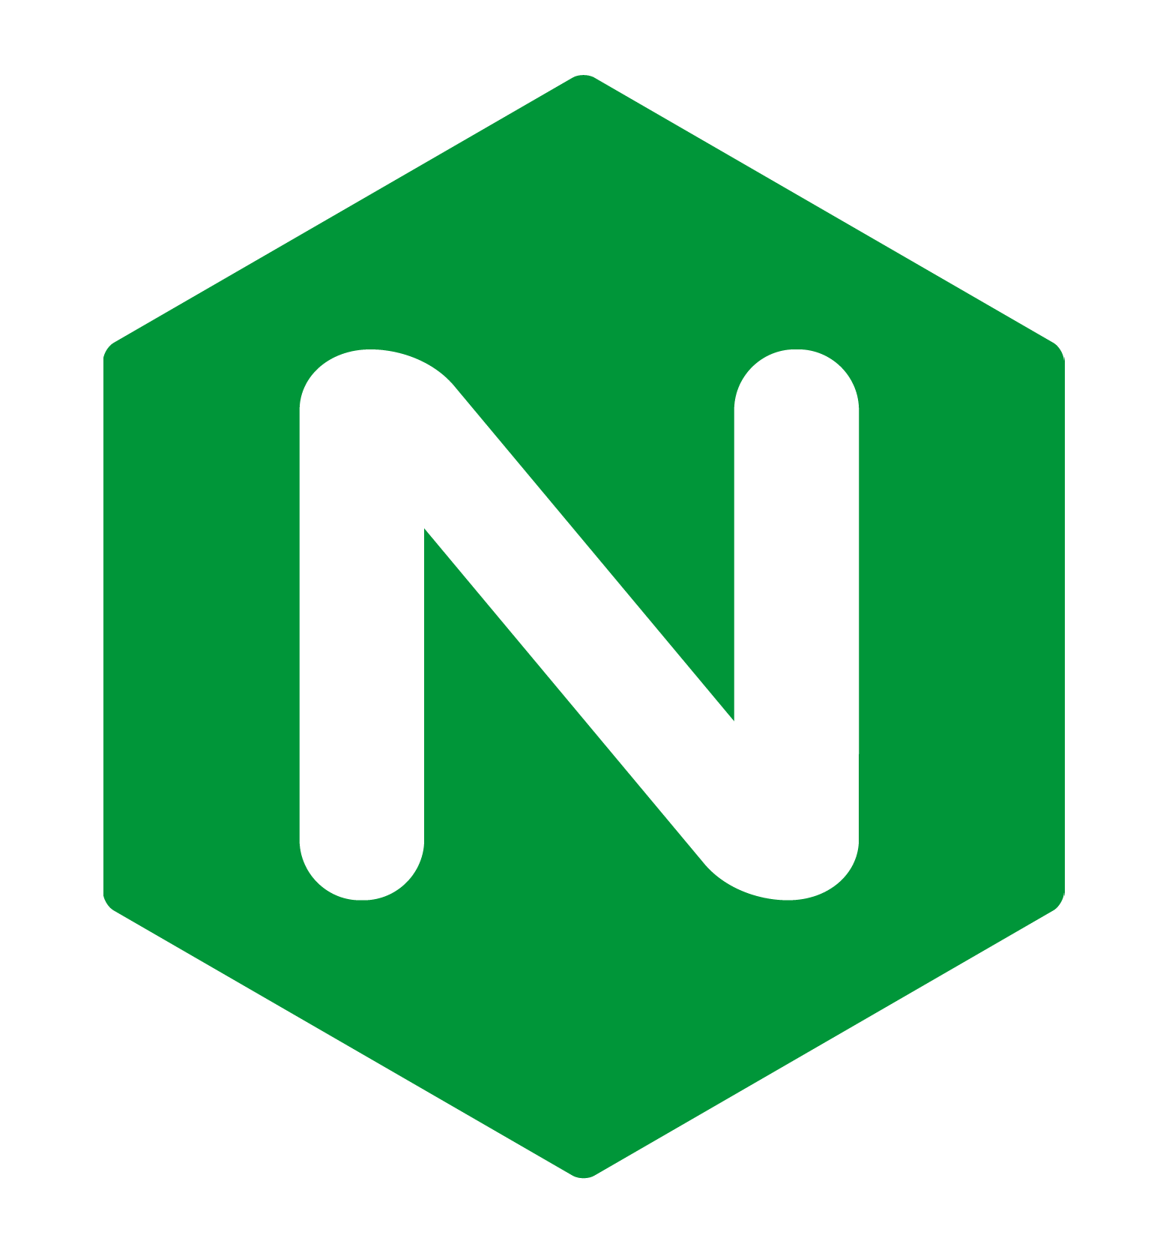




AKS – Fully Secure Private Clusters
VNET
https://docs.microsoft.com/en-ca/azure/aks/ingress-internal-ip
Firewall Subnet
LB Subnet
AKS Subnet
Ingress Directly from Public (Internet) or Private Network
Private IP
https://docs.microsoft.com/en-us/azure/aks/private-clusters
IP Address
Ingress Path
Egress Path
Private IP
Egress Directly to Public (Internet) or Private Network
https://docs.microsoft.com/en-us/azure/aks/limit-egress-traffic#required-ports-and-addresses-for-aks-clusters
Egress using User Defined Route (UDR aka Route Table) on Subnet
Rule: 0.0.0.0/0 -> Firewall Private IP Address
https://docs.microsoft.com/en-ca/azure/firewall/integrate-lb

Slide 14
AKS “Private Clusters”
VNET
Azure
LB Subnet
AKS Subnet
https://docs.microsoft.com/en-us/azure/aks/private-clusters
* Requires the ability to resolve to Azure DNS
(conditional forwarder or using Azure Private DNS Zone Linked)

Slide 15
AKS – “Public Clusters” and Outbound Type: Load Balancer
Public Internet
VNET
LB Subnet
AKS Subnet
Public IP

Slide 16
AKS – “Public Clusters” and Outbound Type: UserDefinedRoute
Public Internet
VNET
Firewall Subnet
LB Subnet
AKS Subnet
Public IP
IP Address
Private IP
Egress using User Defined Route (UDR aka Route Table) on Subnet
Rule: 0.0.0.0/0 -> Firewall Private IP Address

Slide 17
AKS – Fully Secure Private Clusters
Private Clusters + OutboundType: UDR
VNET
https://docs.microsoft.com/en-ca/azure/aks/ingress-internal-ip
Firewall Subnet
LB Subnet
AKS Subnet
Ingress Directly from Public (Internet) or Private Network
Private IP
https://docs.microsoft.com/en-us/azure/aks/private-clusters
IP Address
Ingress Path
Egress Path
Private IP
Egress Directly to Public (Internet) or Private Network
https://docs.microsoft.com/en-us/azure/aks/limit-egress-traffic#required-ports-and-addresses-for-aks-clusters
Egress using User Defined Route (UDR aka Route Table) on Subnet
Rule: 0.0.0.0/0 -> Firewall Private IP Address
https://docs.microsoft.com/en-ca/azure/firewall/integrate-lb

Slide 18
AKS – Secure Ingress
VNET
https://docs.microsoft.com/en-ca/azure/aks/ingress-internal-ip
Firewall Subnet
LB Subnet
AKS Subnet
Ingress Directly from Public (Internet) or Private Network
Private IP
DNAT
https://docs.microsoft.com/en-us/azure/aks/private-clusters
IP Address
Ingress Path

Slide 19
AKS – Secure Egress
Private Clusters + OutboundType: UDR
VNET
https://docs.microsoft.com/en-ca/azure/aks/ingress-internal-ip
Firewall Subnet
LB Subnet
AKS Subnet
https://docs.microsoft.com/en-us/azure/aks/private-clusters
IP Address
Egress Path
Private IP
Egress Directly to Public (Internet) or Private Network
https://docs.microsoft.com/en-us/azure/aks/limit-egress-traffic#required-ports-and-addresses-for-aks-clusters
UDR
Egress using User Defined Route (UDR aka Route Table) on Subnet
Rule: 0.0.0.0/0 -> Firewall Private IP Address
https://docs.microsoft.com/en-ca/azure/firewall/integrate-lb

Slide 20
Thank you.
Ray Kao
OSS/Cloud Native Architect
Azure Global Black Belt Team
@RayKao

